Slide 1



THÁI SÒUL
Huong noi Company

Slide 2





MEMBERS
Tấn Kiệt
Bảo Trân
Thu Ngân
Ngọc Ánh
Anh Tuấn

Slide 3
- As society develops, people become more active and open in all activities. That is, introverts lose their place and are always withdrawn, afraid to communicate. They are afraid of relationships but it seems that everywhere is trendy, bustling, busy and noisy. - Understanding that, Huong Noi company launched a chain of tea shops with the aim of encouraging integration for introverts, giving them a place to share, confide and thereby regain their confidence as well as integrate. with people.
EXECUTIVE SUMMARY

Slide 4
TABLE OF CONTENTS
01.
02.
03.
04.
BACKGROUND
PROPOSAL
MARKET ANALYSIS
BENEFITS
TIMELINE
&
MARKETING PLAN
CONCLUSION
05.
06.

Slide 5
BACKGROUND
01.

Slide 6

BACKGROUND
Che is everyone's favorite food, not only young people but also adults (35 years and older) also love this dish.
This is a delicious, nutritious and cheap dessert from the past to the present.

Slide 7
PROPOSAL
02.

Slide 8
PROPOSAL
WHO
WHAT
WHERE
All ages, all backgrounds, focus on introverts.
Tea shop is especially for those who are afraid to connect, afraid to talk and want to stay away from the hustle and bustle.
The road is small, the space will be quiet and the investment money for the premises is also cheap.

Slide 9

PROPOSAL
WHEN
Starting next month, after the preparations have been completed.
HOW
Operated like a normal tea shop, with delivery support to increase the number of customers.

Slide 10

MARKET ANALYSIS
03.

Slide 11
MARKET ANALYSIS
MARKET PLACE
POTENTIAL CUSTOMERS
COMPETITION
TARGET

Slide 12
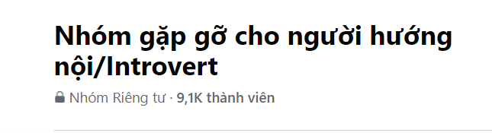
MARKET ANALYSIS
/ market place /
Affirm the shop's position on online and offline platforms
Group for introvert

Slide 13
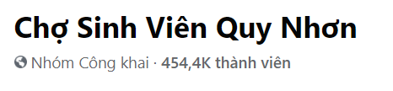
MARKET ANALYSIS
/ market place /
Affirm the shop's position on online and offline platforms
Group that many people access

Slide 14
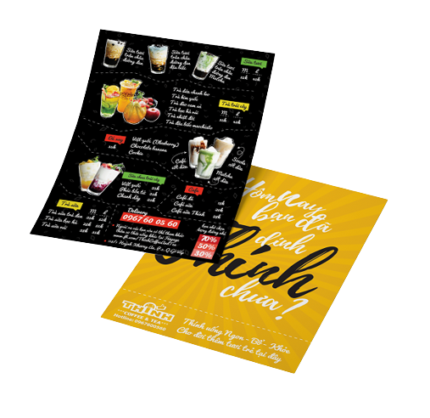
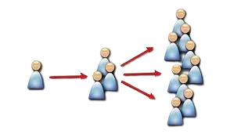
MARKET ANALYSIS
/ market place /
Affirm the shop's position on online and offline platforms
Some way to marketing offline: hand out flyers, word of mouth

Slide 15
MARKET ANALYSIS
/ potential customers /
For introverts: Can find a place to share their feelings, become more open, more confident.
For ordinary people: This can be seen as a quiet space to study, work and spread good values to others.
=> Accessible to everyone

Slide 16
MARKET ANALYSIS
/ competition /
There are many other competitive items such as: Coffee, milk tea, smoothies,...
However, tea is an age-old and affordable food. Moreover, there are not many shops aimed at especially introverts. We are confident about our spread of values.

Slide 17
MARKET ANALYSIS
/ target /
Payback within 1 year.
Started making profits from the 2nd year of business, then expanded and upgraded the brand to a nationwide chain of stores.
Bringing tea to the world.

Slide 18
BENEFITS
04.

Slide 19
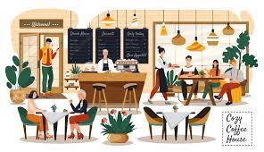
Users will recognize the value that our store brings, thereby contributing to spreading and advertising our brand.
Towards a store that develops sustainably and has a foothold in the market.
BENEFITS

Slide 20
TIMELINE
&
MARKETING PLAN
05.

Slide 21
TIMELINE
Survey of needs and find suitable locations.
Build and decorate the shop.
Attract with Marketing.
Create related Web pages to enhance.
Capital recovery.
Store maintenance and upgrade.

Slide 22

DESKTOP SOFTWARE
MARKETING PLANS
Create a online shop that allow people to get access, order and ship.

Slide 23
MOBILE APP
MARKETING PLANS
You can also easily contact with us via Smartphone.

Slide 24
CONCLUSION
06.

Slide 25
1.000.000
CONCLUSION
Number of cups of tea sold in the first year

Slide 26
3K
12.34%
93.45M
CONCLUSION
Number of customers in first year.
Percent of profit from second year.
Amount earned in the first year.

Slide 27
CONCLUSION
We will do our best to maintain and develop the chain of tea shops for introverts. Hope to receive the attention as well as investment from other units.

Slide 28
THANKS!
Contact us via this platform
thaisoul@gmail.com
0123 456 789
thaisoul.com

